Slide 1
Iteration (loop)

Slide 2
What is loop?
The flow of the programs written in any programming language is sequential by default. Sometimes we may need to alter the flow of the program. The execution of a specific code may need to be repeated several numbers of times.
For this purpose, The programming languages provide various types of loops which are capable of repeating some specific code several numbers of times.
Loop is the act of repeating a process.
Execute a block of code from start to end.
Depending on condition: either finish or go back to start and repeat
Also known as iteration or looping

Slide 3
Iteration….
It is used to iterate over elements of a sequence ( list, tuple, string ,….etc.), it is often used when you have a piece of code which you want to repeat ‘n’ number of times.
There are two types of loop is available in python
For-loop
While loop
This is less like the for keyword in other programming language, and works more like an iterator method as found in other object-orientated programming languages.

Slide 4
for loop :
The for statement in python differs a bit from what you may be used to in C or Pascal. Rather than always iterating over an arithmetic progression of numbers(like in Pascal), or giving the user the ability to define both the iteration step and halting condition(as c ), python’s for statement iterates over the items of any sequence(a list, a string, a tuple), in the order that they appear in the sequence .
Point to remember is for loop is used to iterate over the sequence and also to print block of statement ‘n ’ number of times.

Slide 5
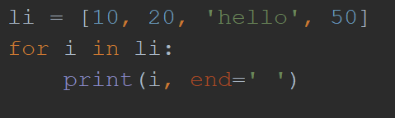

for loop iterating over List :
Output

Slide 6
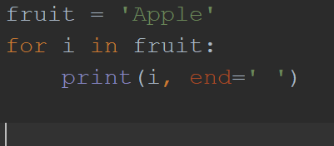

For loop iterating over string :
Output

Slide 7
for loop repeating n number of times:
To repeat a single statement or block of statement in python we can use for- loop
Before that we have to know about range() function;
range() is a built-in function of python.
The range( ) function generates the integer numbers between the given start integer to the stop integer, which is generally used to iterate over with for Loop.
Python range() accepts an integer and returns a range object, which is nothing but a sequence of integers

Slide 8
range ( ) function:
range( start, stop, step)
If we pass only one arguments in range function it will start by default from 0 and increment with 1 and generate sequence of number up to the given number less than 1.
for ex : range (5): 0, 1, 2, 3, 4
To generate specific range we have to insert two argument i.e. start and stop value
Ex:: range(2,6) 2,4,5

Slide 9
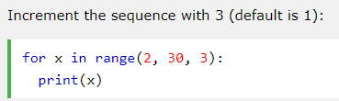
Range…..
To generate number with more than 1 increment we have to use three arguments.
Range(2,10,2) ➔ 2,4,6,8
Now, by using range we can repeat statements any number of times.
for x in range(5)
Print(‘softwarica’)
It will print softwarica 5 times.

Slide 10
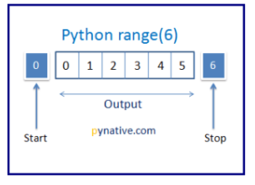
range…
for x in range(0,5):
Print(x)
➔ it will print 0,1,2,3,4
for x in range(10,50):
Print(x)
➔ it will print from 10 to 49

Slide 11
Task:
Write a program to create a list and find the sum of each element of list?
Write a program to create a list and display the each element of list?
Write a function to display the sum of element of list?
Write a program to print area of rectangle 3 times by taking user input?

Slide 12
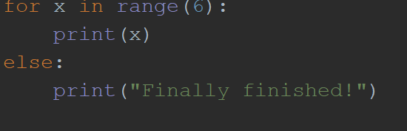
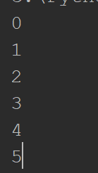
for-else :
The else keyword in a for loop specifies a block of code to be executed when the loop is finished:
Output

Slide 13
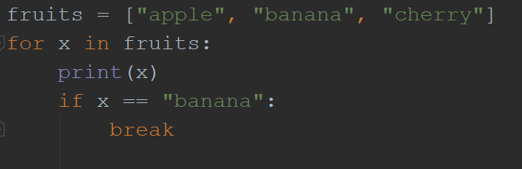
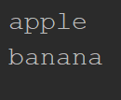
break statement(keyword)
With the break statement we can stop the loop before it has looped through all the items.
Output

Slide 14
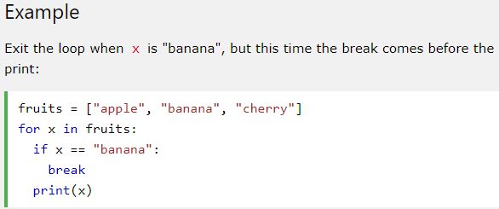
Break….
Find Output

Slide 15
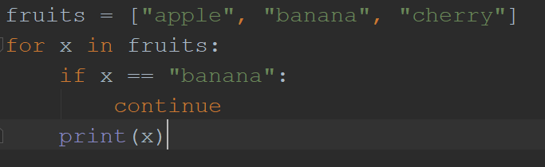
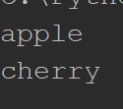
continue Statement(keyword):
With the continue statement we can stop the current iteration of the loop, and continue with the next:
output
It will not print banana because the continue statement forwards the flow towards the loop after it is executed

Slide 16
Nested loop :
Structure within a structure is known as nested loop
For example if loop inside selection statement or if statement inside a loop or loop inside loop is known as nested loop.
for x in range(5):
If statement
If statement
For x in range(5)
For x in range(4):
For x in range(5)

Slide 17
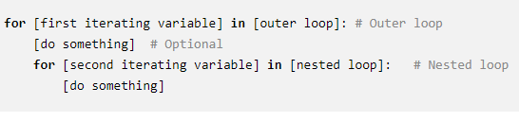
Nested for loop:
Python programming language allows to use one loop inside another loop. Following section shows few examples to illustrate the concept.
A nested loop is a loop that occours within another loop, structurally similar to nested if statements. These are constructed like so:

Slide 18
Nested for-loop ….
The program first encounter the outer loop, executing its first iteration. This first iteration triggers the inner, nested loop, which then runts to completion. Then the program returns back to the top of the outer loop, completing the second iteration and again triggering the nested loop.
Again, the nested loop runs to completion, and the program returns back to the top of the outer loop until the sequences is complete or break or other statement disrupts the process.
Let’s consider one example :

Slide 19
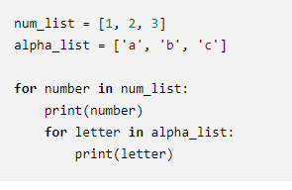
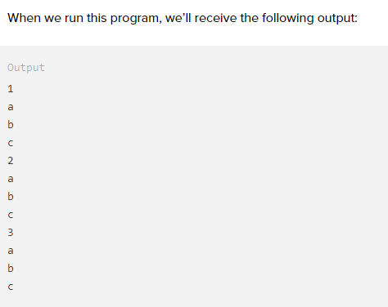
Example of nested for loop:
Output

Slide 20
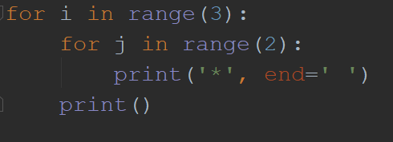

Nested for loop….
Nested for loop is mostly used in pattern printing and printing data in row and column format( tabular format)
output

Slide 21
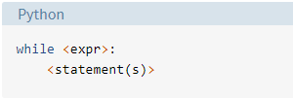
While loop:
With the while loop we can execute a set of statements as long as a condition is true
<statement(s)> represents the block to be repeatedly executed, often referred to as the body of the loop. This is denoted with indentation, just as in an if statement
The controlling expression, <expr>, typically involves one or more variables that are initialized prior to starting the loop and then modified somewhere in the loop body.
When a while loop is encountered, <expr> is first evaluated in Boolean context. If it is true, the loop body is executed. Then <expr> is checked again, and if still true, the body is executed again.
This continues until <expr> becomes false, at which point program execution proceeds to the first statements beyond the loop body.

Slide 22
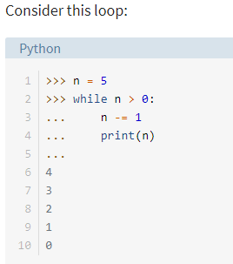
Example :
Note that we can use break and continue statement in while loop also.

Slide 23
Difference between the for loop and while loop:
The only one difference from the aspect of implementing is – for loop is used when the number of repetition is fixed and while loop is used when the number repetition is not fixed.
Consider the example given in the lecture class

